Slide 1

The Digital Rainbow & Neuro Games (UI)
Frontend using HTML CSS website creation using Templates
Mohit Pant
GU-2022-4182
B.Tech CSE 5th sem.

Slide 2

Basics of HTML and CSS
1
HTML
HTML is an abbreviation of Hyper Text Markup Language is used to write code for websites.
CSS
2
CSS is an abbreviation of cascading style sheet is used for writing code for
Design layouts of a website so that they can be user interactive.

Slide 3

Introduction
Greetings fellow explorers of the digital realm! I am excited to unveil IT Services
(the digital rainbow (clone)), a testament to my journey in web development where HTML and CSS
converge to recreate the magic of a well-established website. Join me on this virtual adventure
as we navigate through the intricacies of code and design, unveiling a meticulously crafted clone that
mirrors the essence of its source.

Slide 4

Project Explanation
The project encompasses a detailed analysis of Digital Rainbow's website structure, user interface.
Through reverse engineering and meticulous examination, the team will identify key components,
algorithms, and design patterns that contribute to the seamless delivery of IT services. This process
will serve as the foundation for the development of an identical, yet technologically updated, version
of the website.

Slide 5
Hardware Requirements
Processor: i3
Ram: 4GB
SSD/HDD: 256GB

Slide 6
Software Requirements
Front-end: HTML, CSS, Bootstrap.
OS: Windows Operating System/Linux
Environment: IDE (Any)

Slide 7
ScreenShots

Slide 8
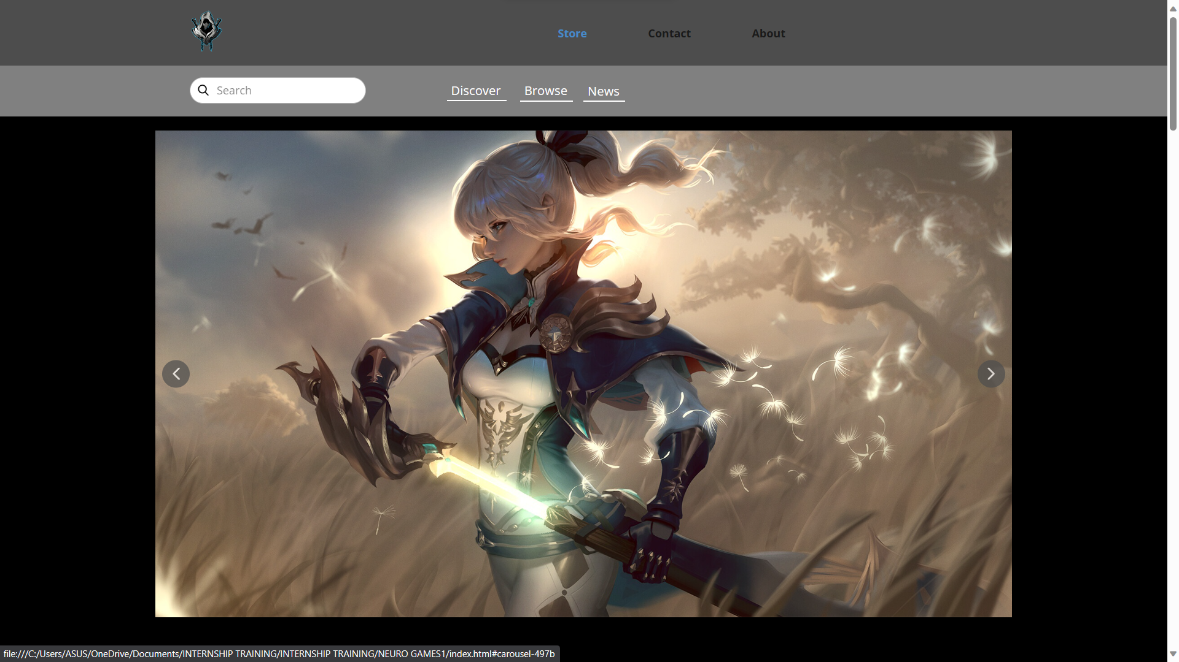

Slide 9
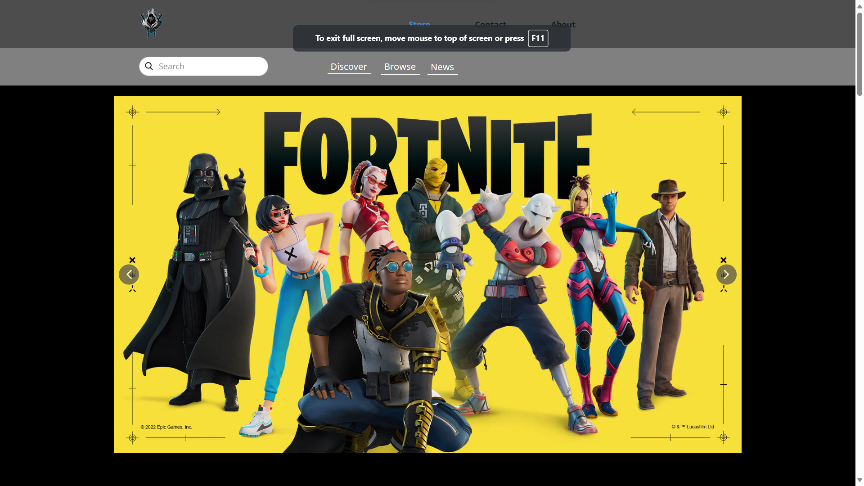

Slide 10
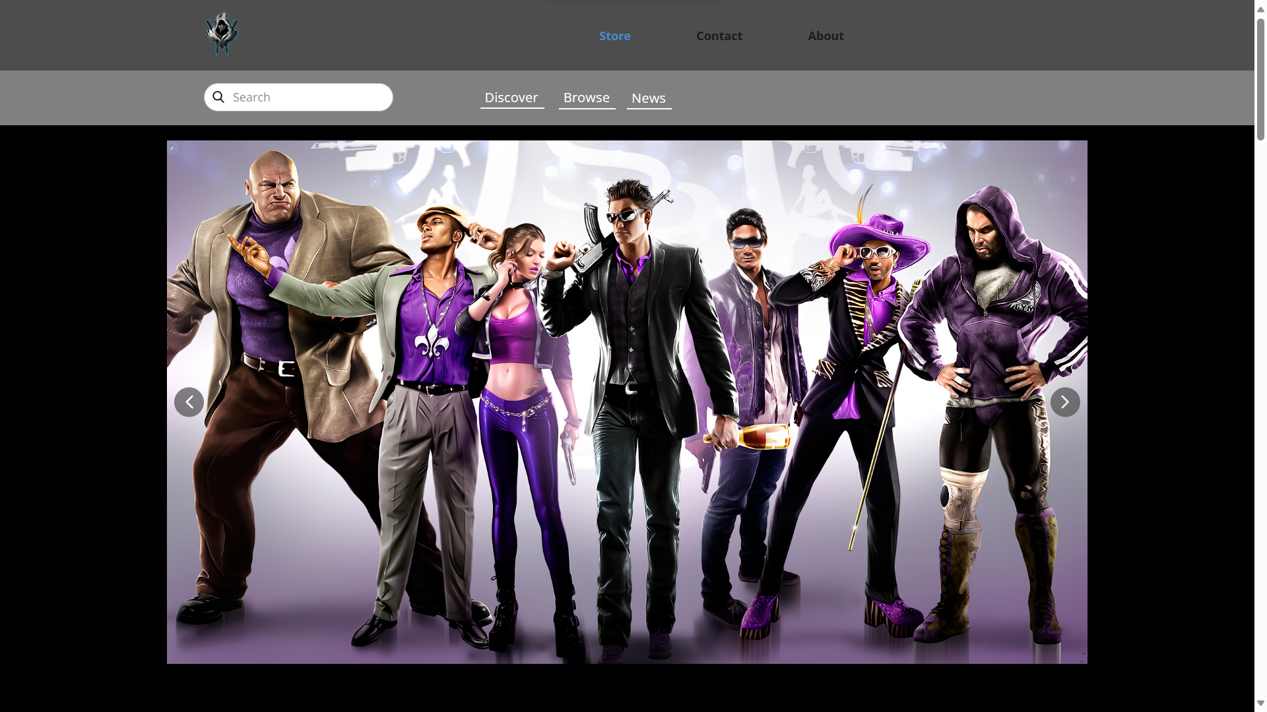

Slide 11
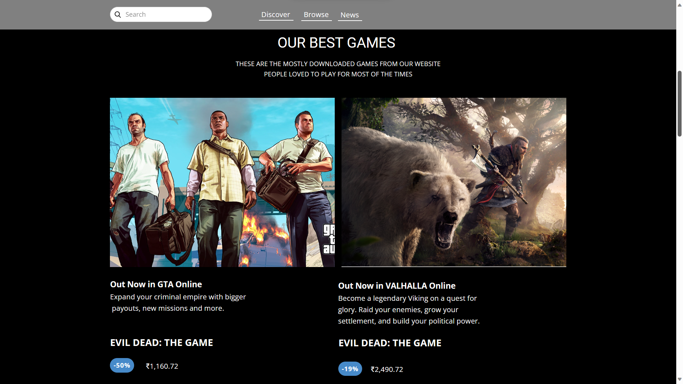

Slide 12
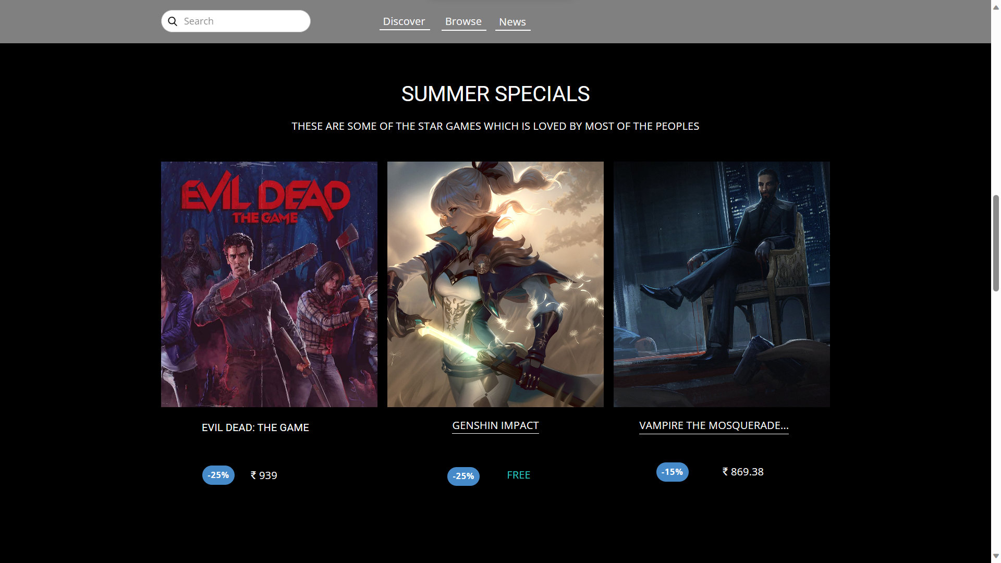

Slide 13
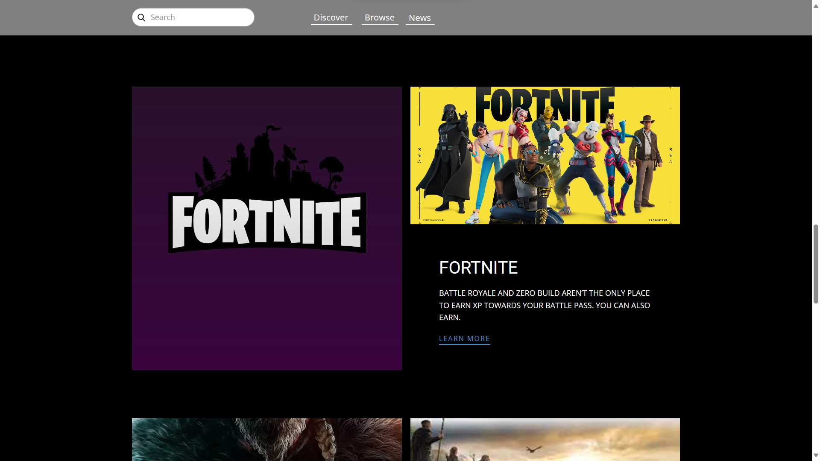

Slide 14
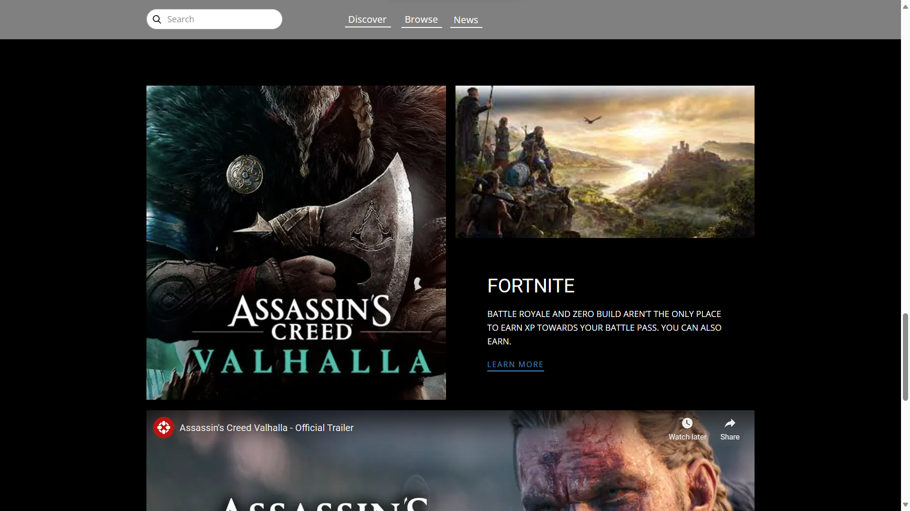

Slide 15
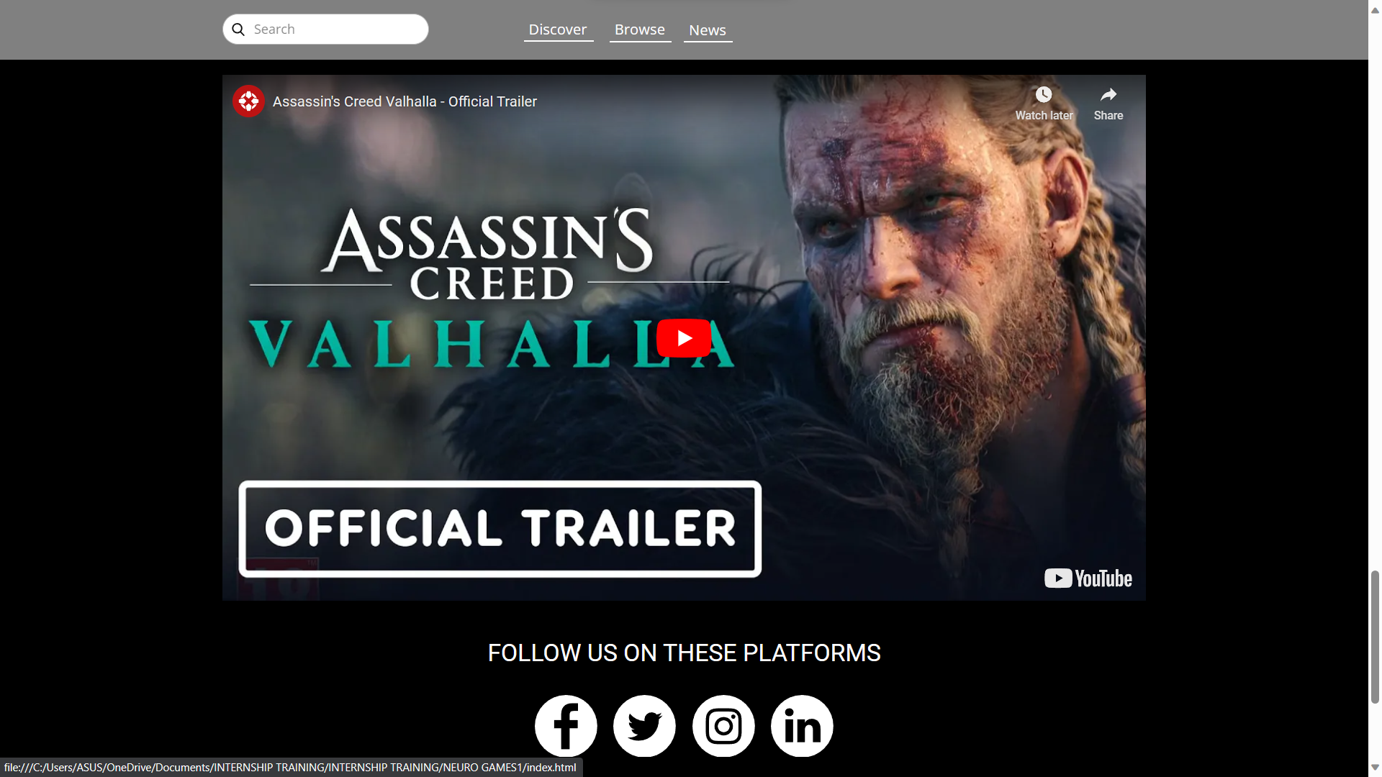

Slide 16
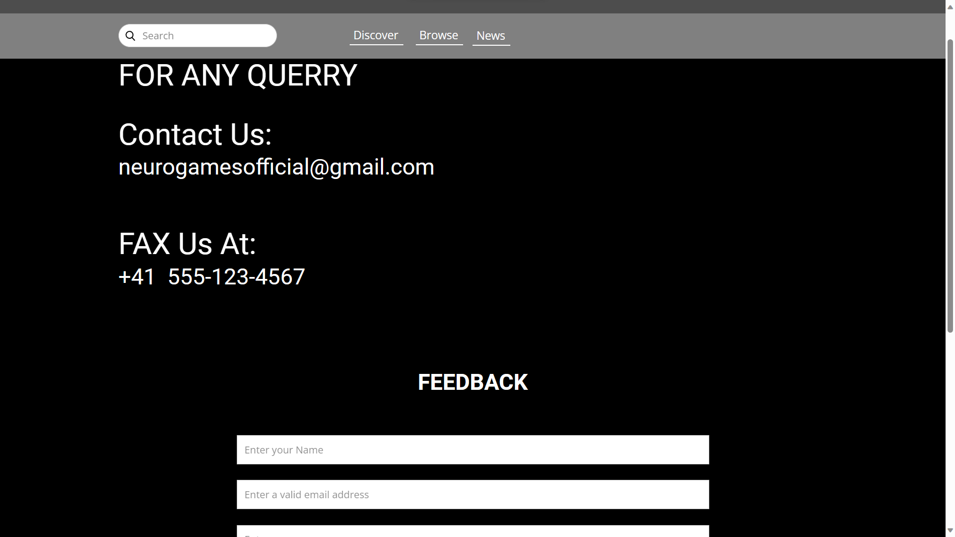

Slide 17
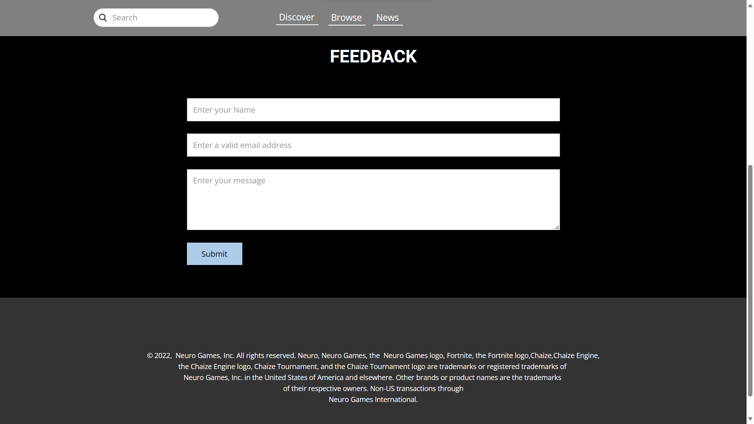

Slide 18
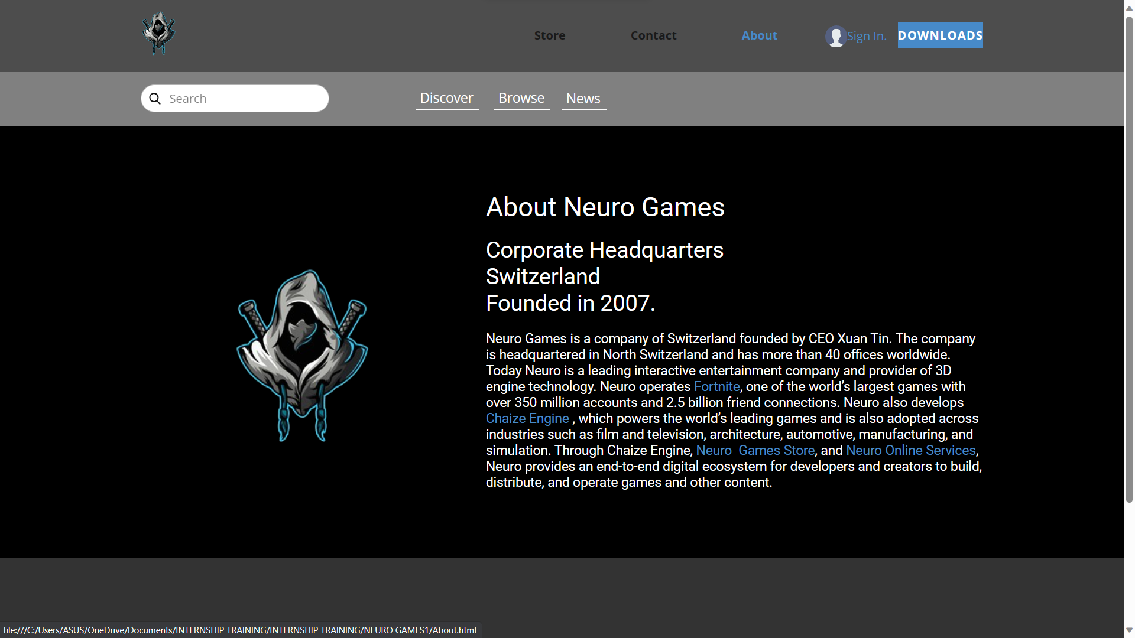

Slide 19


Slide 20


Slide 21


Slide 22


Slide 23
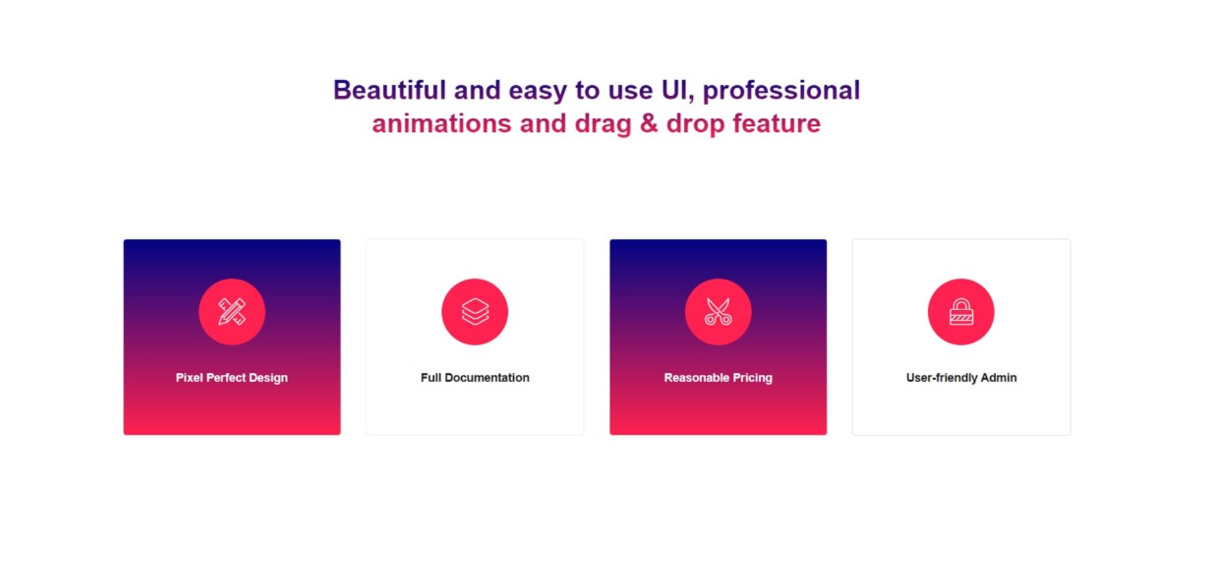

Slide 24


Slide 25
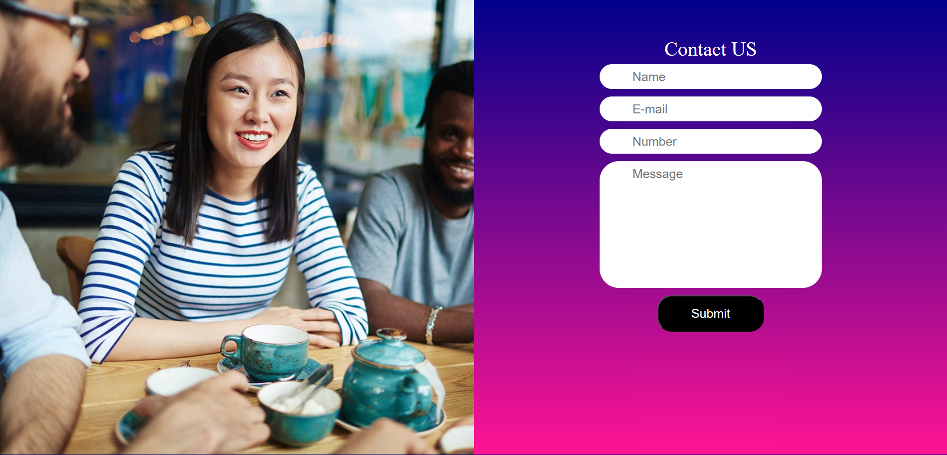

Slide 26
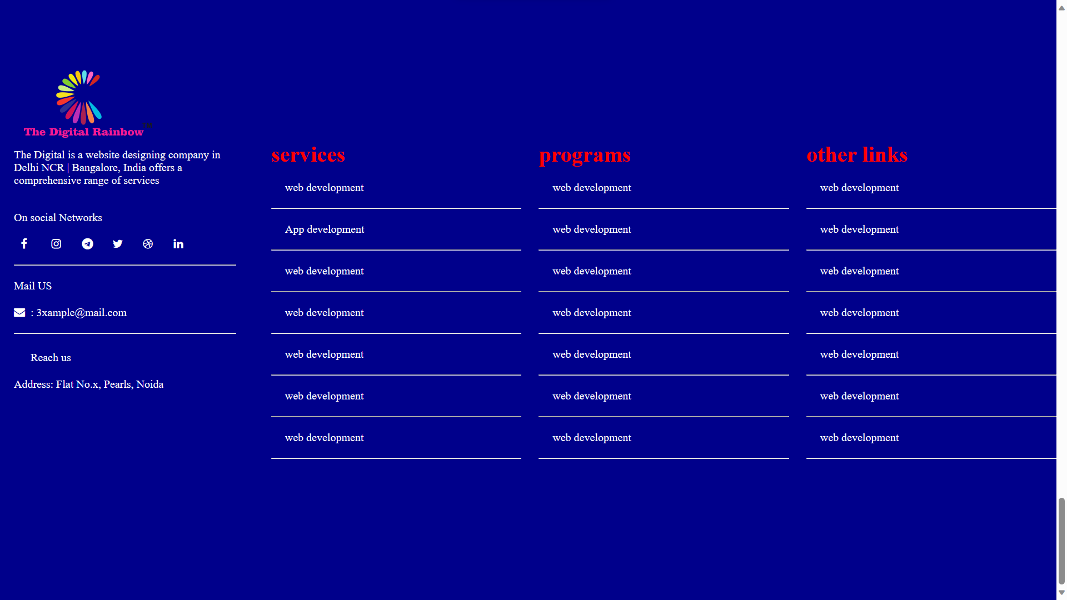

Slide 27
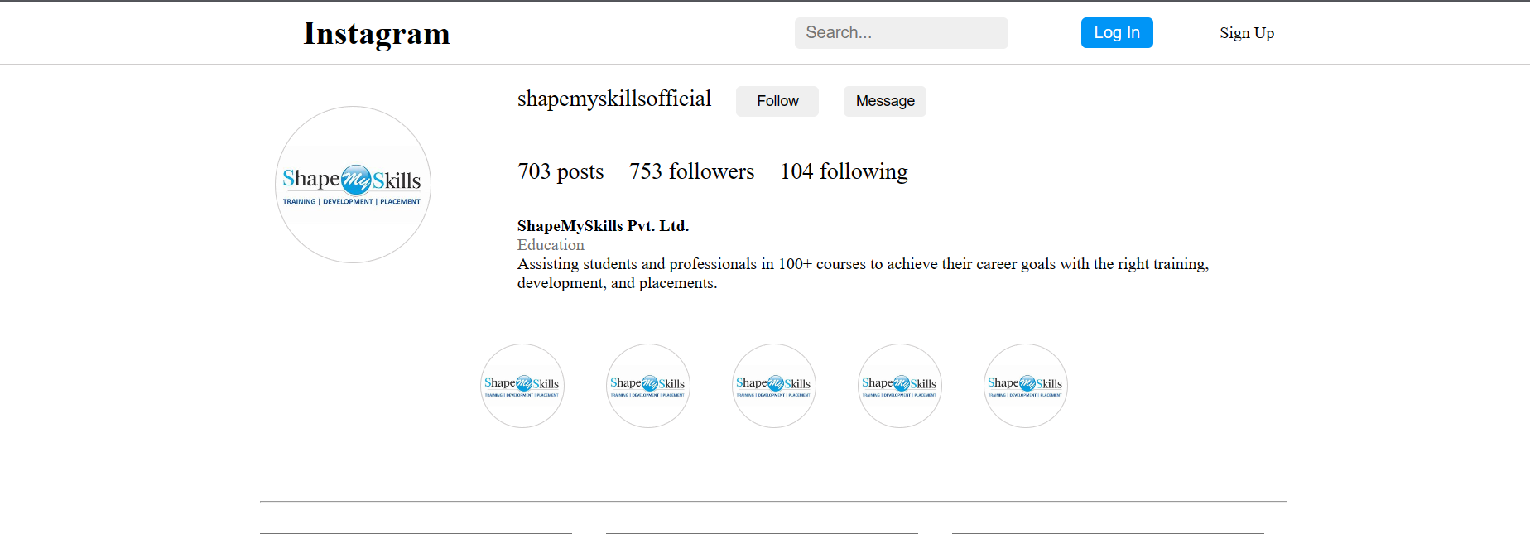

Slide 28
Conclusion
UI’s provides a comprehensive solution for designing
websites.
These Technologies offers efficient and robust coding
skills.
By utilizing HTML, CSS ensuring that website is user
interactive.

Slide 29
Feedback
In summer internship I met with variety of peoples and
able to understand their project, problems in projects and
help them it was so enjoyable to be with them and learn
with them as a team.

Slide 30
Thank you

